Slide 1




NEXT GEN EMPLOYABILITY PROGRAM
Creating a future-ready workforce
Team Members
College Name
Student Name :KUGAN.K
Student ID :au511321104044
KINGSTON ENGINEERING COLLEGE
(5113)

Slide 2

CAPSTONE PROJECT SHOWCASE
Project Title
Building Bus Reservation System using Python and Django
Abstract | Problem Statement | Project Overview | Proposed Solution | Technology Used | Modelling & Results | Conclusion

Slide 3
Abstract
This project focuses on the development of a robust Bus Reservation System using Python programming language and the Django web framework. The system aims to streamline the process of bus ticket booking, providing users with a seamless and efficient experience. Key features include user authentication, a user-friendly interface for searching and selecting routes, real-time availability of seats, secure payment processing, and administrative tools for managing buses, routes, and reservations. By leveraging the power of Django's built-in functionalities such as ORM (Object-Relational Mapping) and authentication system, along with Python's flexibility and simplicity, the project aims to deliver a scalable and customizable solution for bus reservation needs. Through this project, users can expect an intuitive platform that simplifies the bus booking process while ensuring reliability and security.
Source :

Slide 4
Problem Statement
The current bus reservation system lacks efficiency and user-friendliness, leading to inconvenience for both passengers and operators. Manual booking processes result in long queues, errors in ticketing, and inefficient resource allocation. Additionally, the absence of real-time tracking and dynamic seat selection makes it challenging for passengers to plan their journeys effectively. Moreover, the system lacks scalability and adaptability to meet the evolving needs of the transportation industry.
To address these challenges, there is a critical need to develop a modernized Bus Reservation System using Python and Django. This system should incorporate features such as real-time tracking, dynamic seat selection, multi-language support, and integration with external APIs for weather updates and route optimization. By leveraging innovative technology, the new system aims to enhance user experience, streamline operations, and improve overall efficiency in the bus reservation process.
Source :

Slide 5
Project Overview
The Bus Reservation System project aims to facilitate efficient and convenient booking of bus tickets through a user-friendly web application developed using Python and Django framework. The system provides a platform for users to search for available buses based on their travel route, date, and time preferences. Users can then select their preferred bus, view seat availability, and book tickets seamlessly.
Key features of the system include user authentication, allowing users to register and login securely to access the booking functionalities. It also incorporates an admin panel to manage buses, routes, schedules, and user bookings effectively. The system employs a relational database to store information about buses, routes, bookings, and user profiles.
Furthermore, the system ensures a smooth booking experience by integrating payment gateways for secure online transactions. It also sends confirmation emails to users upon successful booking and generates e-tickets for their convenience.
Overall, the Bus Reservation System project leverages Python and Django to create a robust, scalable, and user-friendly platform that streamlines the bus booking process, enhancing customer satisfaction and operational efficiency for bus operators.
Source :

Slide 6
Proposed Solution
Database Design:
Create the following database models using Django ORM:
User: To store user information like username, email, password hash, etc.
BusRoute: To store information about bus routes including route name, source, destination, and duration.
BusSchedule: To store bus schedules for each route including departure time, arrival time, and associated bus.
Booking: To store booking details such as user, selected seats, booking status, etc
.
User Authentication:
Implement user registration and login functionality using Django's built-in authentication system.
Use Django's forms for user input validation and security against common vulnerabilities like CSRF.
Admin Panel:
Utilize Django Admin for easy management of bus routes, schedules, and bookings.
Customize the admin interface to provide a user-friendly experience for administrators.
Source :

Slide 7
Frontend Development:
Develop responsive frontend templates using HTML/CSS and Bootstrap for user interfaces.
Implement JavaScript for dynamic features such as seat selection and form validation.
Use AJAX for seamless interaction between frontend and backend for real-time updates.
Bus Route Management:
Create CRUD (Create, Read, Update, Delete) functionality for managing bus routes in the admin panel.
Implement form validation to ensure data integrity and consistency.
Bus Schedule Management:
Allow admins to add/edit/delete bus schedules for each route in the admin panel.
Implement logic to prevent overlapping schedules and ensure data consistency.
Source :

Slide 8
Seat Selection:
Display available seats on buses using a graphical interface (e.g., grid layout).
Enable users to select seats by clicking on them and update the UI in real-time.
Prevent multiple users from booking the same seat simultaneously.
Booking Process:
Implement logic to handle booking requests, validate user input, and reserve selected seats.
Calculate total fare based on the number of seats and any applicable taxes or discounts.
Integrate with payment gateway APIs for secure online payments.
Ticket Generation:
Generate tickets in PDF format containing booking details like route, schedule, seats, fare, etc.
Send confirmation emails to users with their ticket attached upon successful booking.
Source :

Slide 9


Technology Used
Front-end
Back-end
Source :

Slide 10
Modelling & Results
In the Bus Reservation System built with Python and Django, the database model includes entities such as User, BusRoute, BusSchedule, and Booking. Users can register, login, and browse available bus routes. Admins can manage routes, schedules, and bookings via the Django Admin panel. Frontend templates utilize HTML/CSS with Bootstrap for responsive design, and JavaScript for dynamic features like seat selection. The system ensures data integrity with form validation and prevents overlapping schedules. Upon booking, tickets are generated in PDF format, and confirmation emails are sent to users. In testing, unit tests and end-to-end tests ensure functionality and performance. Deployment on platforms like Heroku or AWS facilitates accessibility. With ongoing maintenance and support, the system continuously improves, providing a seamless experience for both users and administrators.
Source :

Slide 11
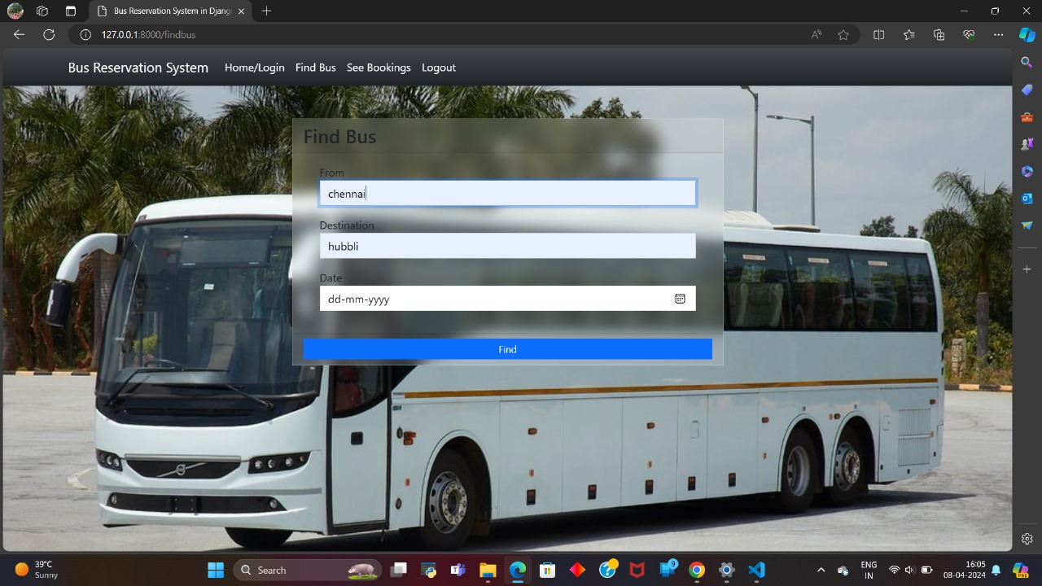
Login page

Slide 12
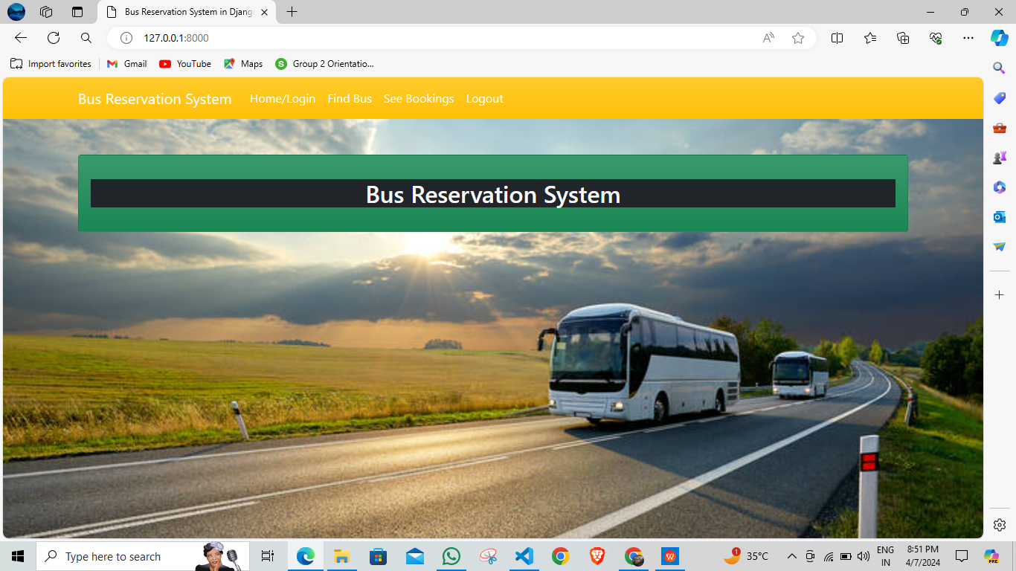
Home Page

Slide 13
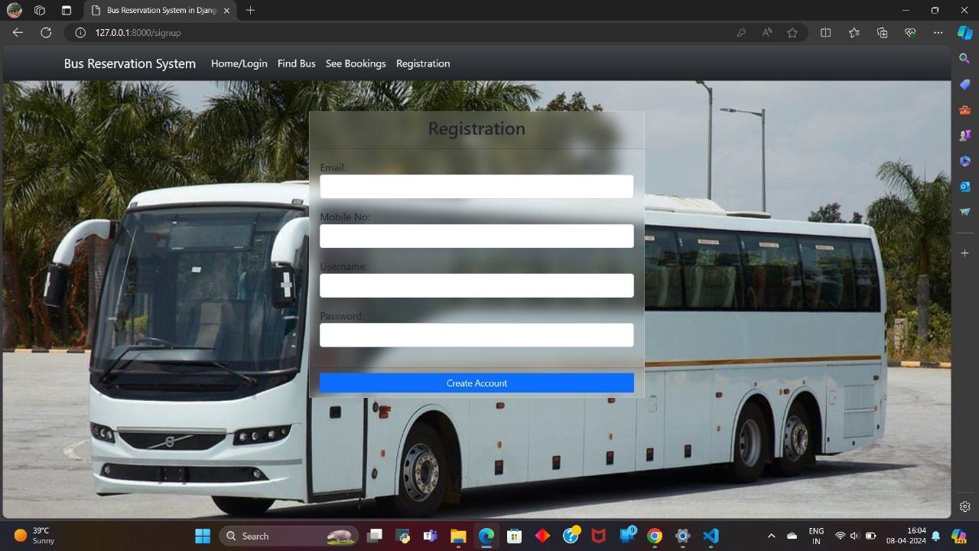
Log Out Page

Slide 14
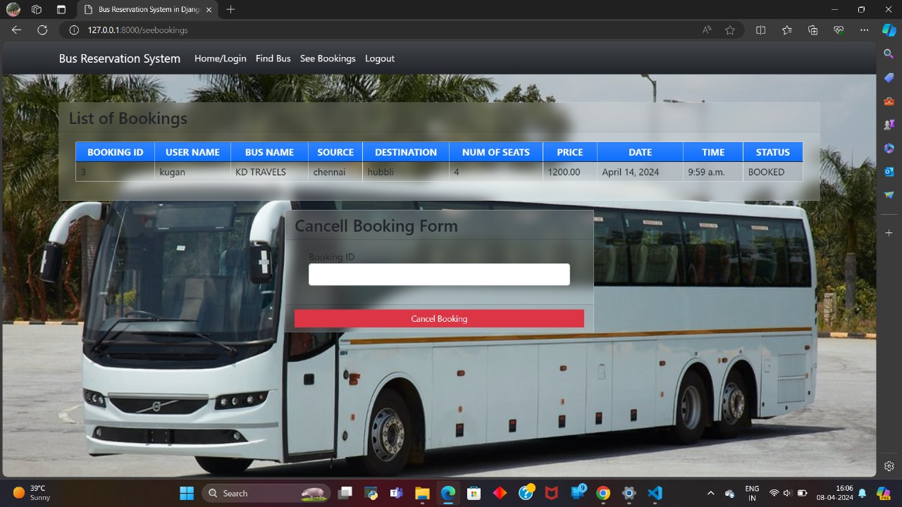
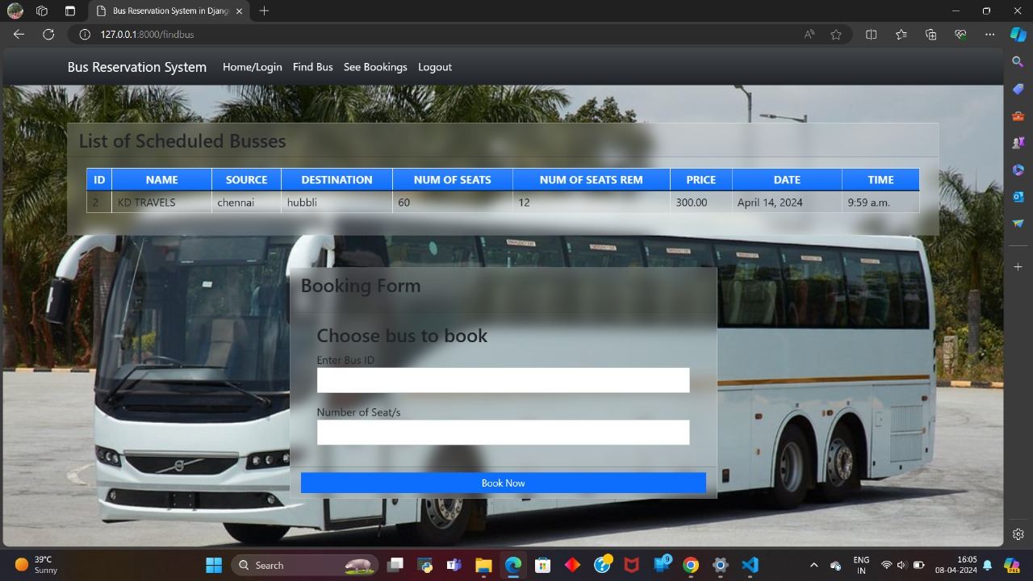
Service Page

Slide 15
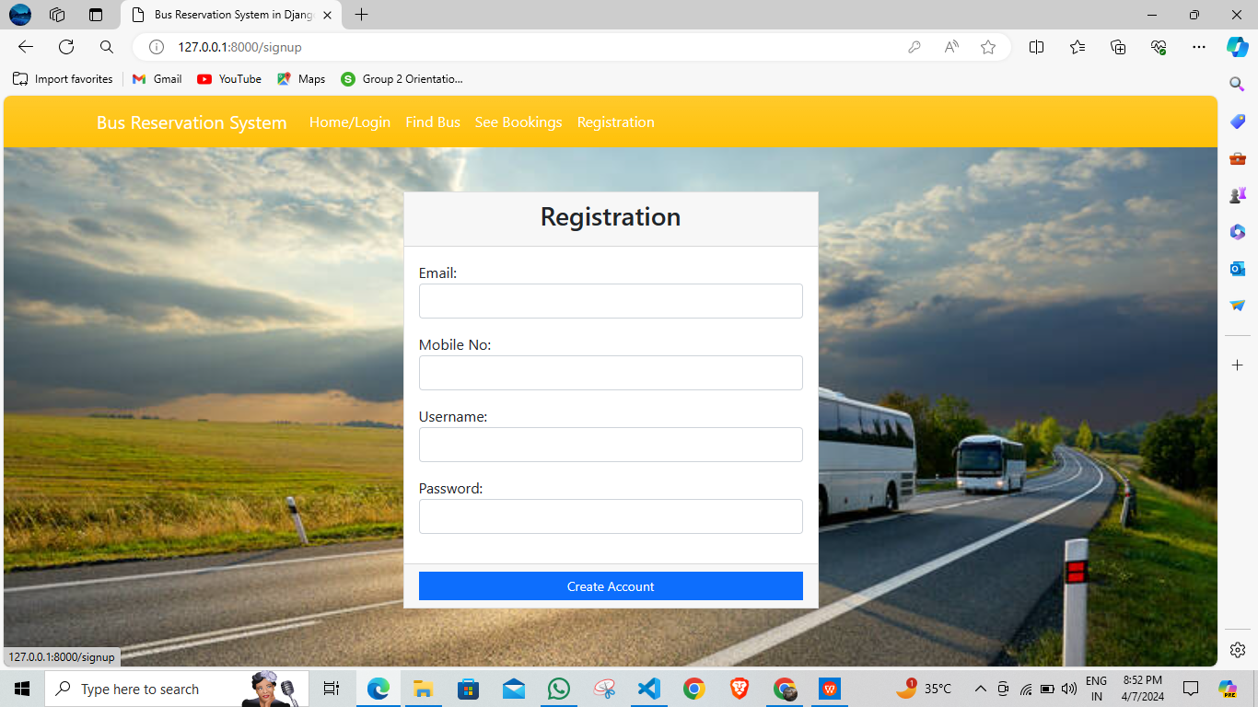
Registration page

Slide 16
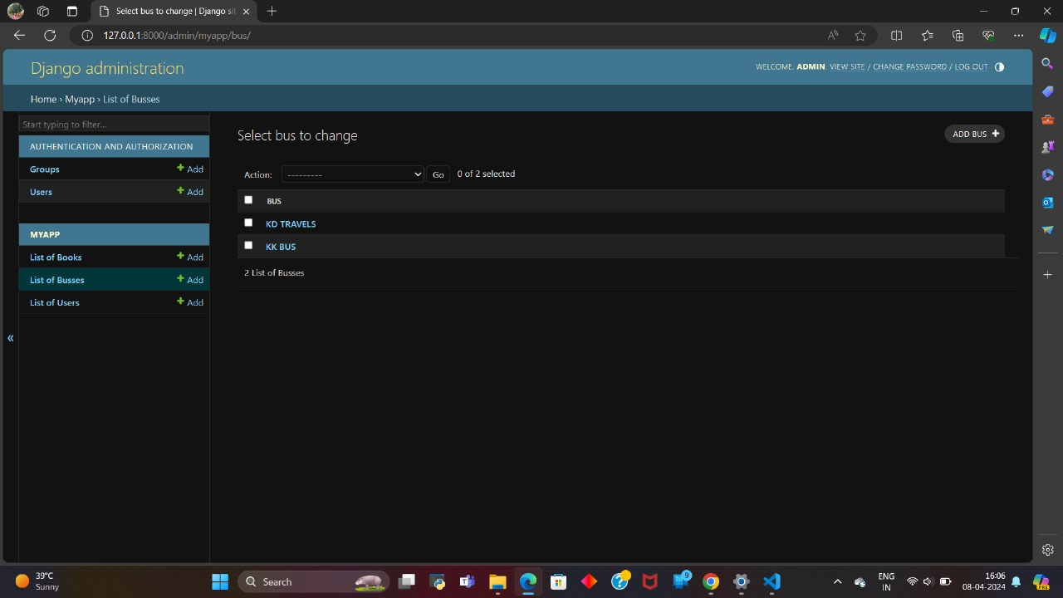
Django administration Page

Slide 17
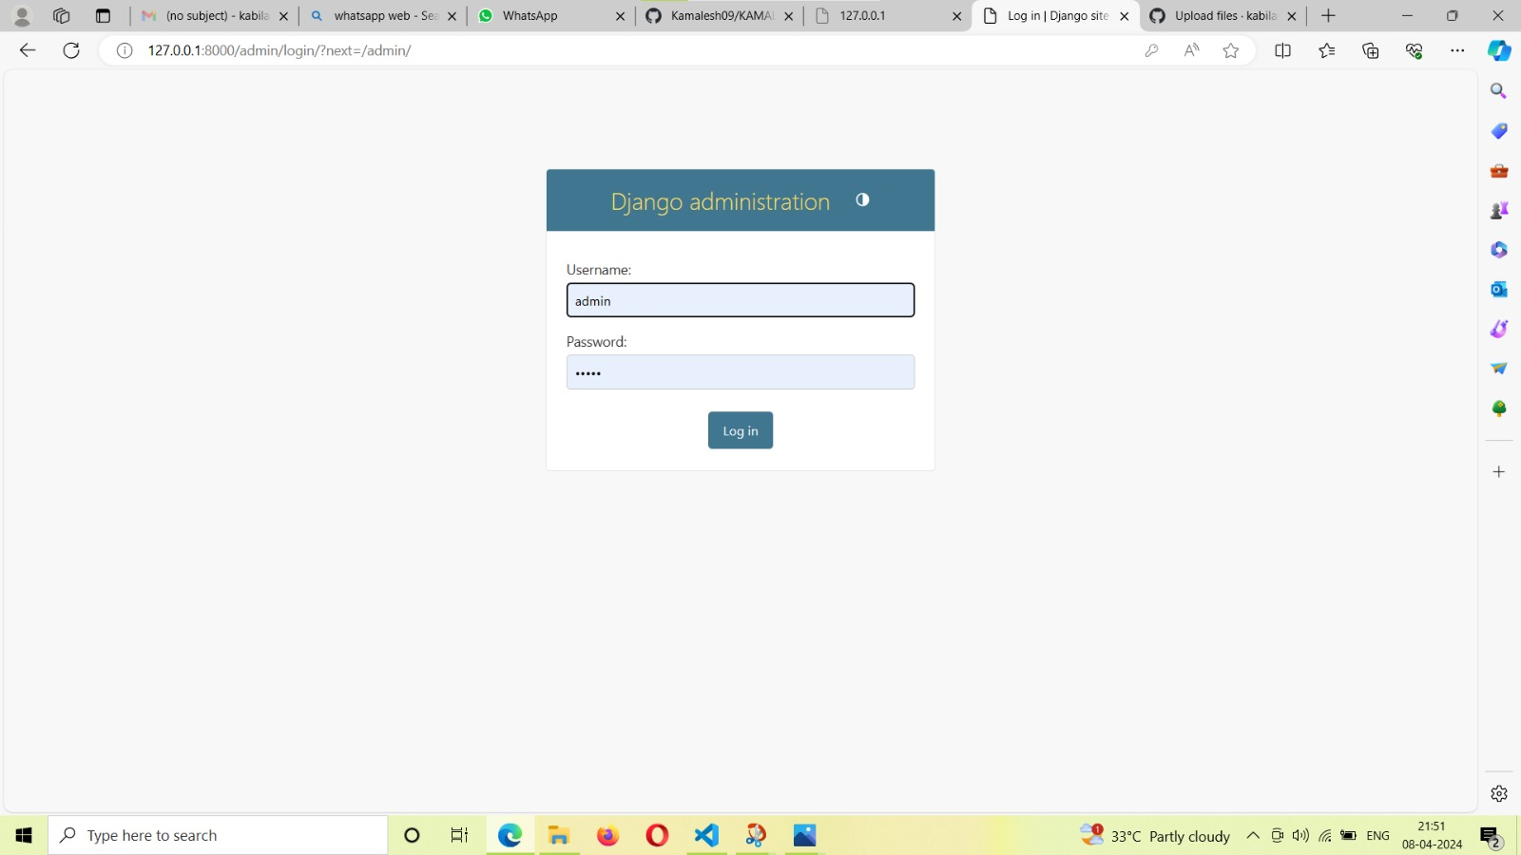
Django administration Page

Slide 18
Future Enhancements:
In enhancing a Bus Reservation System built with Python and Django, several features can be implemented to improve user experience and efficiency. Integration of real-time GPS tracking enables passengers to track bus locations and estimated arrival times accurately. Implementing a dynamic pricing system based on factors like demand, time of booking, and seat availability can optimize revenue and enhance customer satisfaction. Incorporating a mobile app interface allows for seamless booking, cancellations, and updates on the go. Integration with popular payment gateways ensures secure and convenient transactions. Additionally, introducing a recommendation engine based on user preferences and historical data can personalize the booking experience. Implementing an admin dashboard with advanced analytics provides insights into booking patterns, revenue generation, and fleet management, aiding in decision-making and optimization. Continuous monitoring and updates to ensure scalability, security, and reliability are crucial for future-proofing the system.

Slide 19
Conclusion
In conclusion, the implementation of a Bus Reservation System using Python and Django offers immense potential to revolutionize the transportation industry. Through seamless integration of advanced features such as real-time tracking, dynamic seat selection, and multi-language support, the system promises to enhance user experience and operational efficiency significantly. By leveraging external APIs for weather updates, traffic predictions, and route optimization, passengers can enjoy a smoother journey while operators can streamline their services. Moreover, the incorporation of customer feedback mechanisms and predictive analytics ensures continuous improvement and better decision-making. With features like social media integration and subscription-based services, the system fosters customer engagement and loyalty. Ultimately, the Bus Reservation System stands as a testament to the power of innovative technology in transforming traditional industries, promising convenience, safety, and satisfaction for both passengers and operators alike.
Source :

Slide 20
Thank You!
Notes:
Thank You !!

